Slide 1
UMPIRES →
UMPIRES have the responsibility of reporting all observed infractions in the track events after the start and to the finish.

Slide 2
UMPIRES →
UMPIRES are not timers, starters, field event officials, etc.

Slide 3
UMPIRES →
UMPIRES report all general running, hurdling, and relay infractions.
UMPIRES also report unfair acts and unsportsmanlike conduct incidents as defined by the current NFHS rule book.

Slide 4

UMPIRES →
UMPIRES will be equipped with a yellow and white flag.

Slide 5
UMPIRES will signal that no observed violations occurred by raising a WHITE flag
UMPIRES will signal an observed violation occurred by raising a YELLOW flag

Slide 6
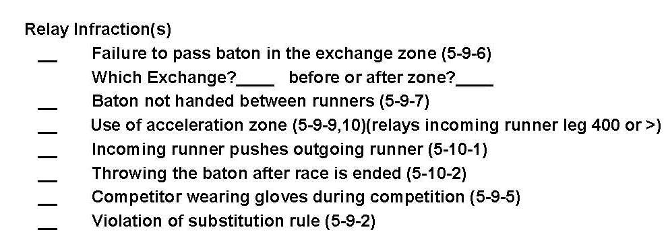
UMPIRES →
UMPIRES that observe an infraction must fill-out a violations report and turn it into the HEAD FINISH JUDGE at the finish line.

Slide 7
UMPIRES →
UMPIRES don’t have to go into great detail. The form is meant to simply check-off and if needed write a brief description.

Slide 8
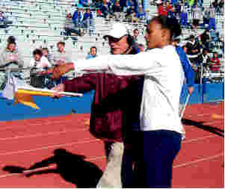
UMPIRES →
UMPIRES do not make the final call.
The referee will make the final call. The referee may want to briefly discuss what happened with the umpire shortly after the violation was reported.

Slide 9
UMPIRES →
UMPIRES should not discuss the call with the coaches, spectators, etc.
The REFEREE will discuss the call with the coach at the appropriate time.

Slide 10
UMPIRES →
RED is the color of choice for apparel. We do want to be somewhat color coordinated and look professional.

Slide 11
UMPIRES →
For state qualification meets, the AIA requires six (6) umpires.
Umpires have to be stationed around the track for each and every race.
We will try to put our three most experienced officials with three of our less experience officials at key areas of the track.

Slide 12
UMPIRES →
For each meet, a sign-in sheet will be posted up in the press box and/or the ticket booth.
All umpires need to sign-in.
When signing in, the umpires will need to pick up a yellow and white flag, a clipboard with the infraction forms, and grab a few pencils.

Slide 13
UMPIRES →
All umpires should bring a snack and a drink.
We do our best to keep the meets under five hours.
We also recommend dressing in layers, wearing a hat, and bring a folding chair.

Slide 14
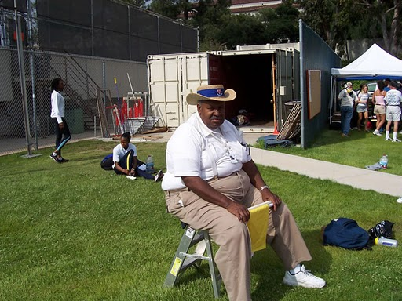
UMPIRES →
UMPIRES may be seated, especially during the distance events.
During the relays, umpires should be standing in order to get the best view.

Slide 15
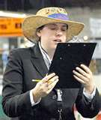
UMPIRES →
UMPIRES when checking in should also get a clipboard, a few pencils, and plenty of infraction forms.

