Slide 1
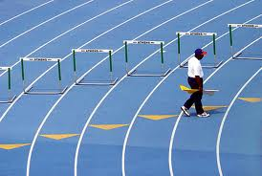
UMPIRES
Umpire(s)—this is the official term for the zone and lane judges for all track events
The AIA requires six (6) umpires for all state qualification meets

Slide 2
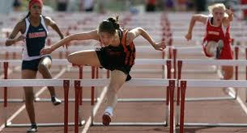
POSITIONS
For the high hurldes
Umpire #1 watches the entire race
Umpire #2 watches the first two flights, Umpire #3 watches the next two flights, and so on.
All umpires will be on the inside of the track.

Slide 3
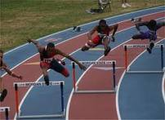
POSITIONS
Use the same positions for the 100m dash as the high hurdles.
For the 300m hurdles, Umpire #1 will watch the first two flights
Umpire #2 will watch the first flight on the curve
Umpire #3 will watch the second flight on the curve
Umpire #4 will watch the third flight on the curve
Umpire #5 will watch the first part of the home stretch.
Umpire #6 will watch the last part of the race
Again, it is best to be on the inside of the track for these races

Slide 4
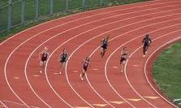
POSITIONS
For the 400 meter dash and all distance races
Umpire #1 is by the scoreboard on the outside of the track.
Umpire #2 is on inside of the track near the 300m hurdles start
Umpire #3 is on the inside of the track near on the backstretch by the 50 yard line
Umpire #4 is on the inside of the track at the top of the curve
Umpire #5 is on the outside of the track near the start of the 100m dash
Umpire #6 is on the inside of the track on the home stretch near the 50 yard line.

Slide 5
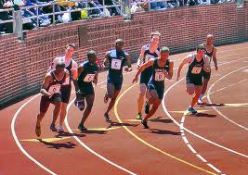
POSITIONS
4 X 100 meter relay
Umpires #1 and #2 will work zone 1 (by the 300m hurdles start)
Umpire #1 will be on the outside of the track 10 meters beyond the end of the exchange zone
Umpire #2 will be on the inside of the track 10 meters before the acceleration zone
Umpires #3 & #4 will correspond to #1 & #2 in zone 2
Umpires #5 & #6 will correspond to #1 & 2 in zone 3

Slide 6
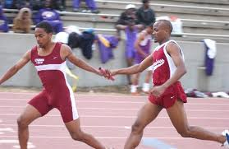
POSITIONS
4 x 200 meter relay
Umpires 1 and 2 cover the zone by the 200m start (first and third exchange). First exchange black, second exchange yellow. Don’t let the #4 runners on until the #1 runners have all left the track.
Umpires 3 and 4 cover zone number two (by the finish line) in black.
Umpires 5 and 6 will watch the curve lines (on the inside of the track by the top of the curve.
Note: this is different than what New Mexico schools do—they stay in their lanes the whole way. They can’t cut in—remind the athletes of that.

Slide 7
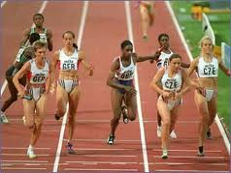
POSITIONS
4 X 400m Relay
Line up just like you do for the 400m dash.
Umpire #6 handles the exchanges.
Note: The #2 runner will cut in at the break line by the 300m hurdles start

Slide 8
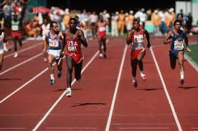
POSITIONS
800m sprint medley
100-100-200-400
Umpires #1 and #2—just like the 4 X 100m relay
Umpires #3 and #4—just like the 4 X 100m relay
Umpires #5 and #6
Cover the third exchange by the finish line

Slide 9
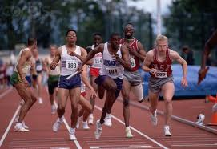
POSITIONS
1600 meter Sprint Medley
200-200-400-800
Umpires 5 and 6 can cover the 200-200 exchange by the 200m start (yellow)
Umpires 3 and 4 can cover the exchanges at the finish line
Umpires 5 and 6 can cover the curves

Slide 10
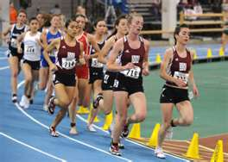
UMPIRES
Umpires must be in-use for all running events.
They are not used just for the relays.

Slide 11
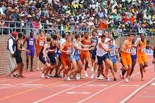
UMPIRES
These are the different types of running events you will be judging
(1) Sprints (start and finish in lanes)
(2) Hurdles
(3) Distance Events
(4) Relays
(5) Steeplechase

Slide 12

PROCEDURES
When an umpire believes an infraction has been committed, a YELLOW flag is raised.
The umpire goes to Head Finish Judge and a written report is made of the infraction.
The Head Finish Judge then sends the infraction report to the referee in the press box
The referee is the one who makes the final decision.

Slide 13
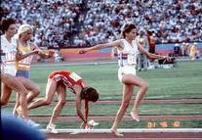
PROCEDURES
When the race passes by your area, and no infraction has been committed, raise your WHITE flag.
If you aren’t sure, raise your YELLOW flag and discuss the situation with the head umpire.
Famous example—the umpire first ruled the Zola Budd-Mary Decker race misstep incident as an infraction on Zola Budd for not giving enough room for cutting in. Then, the head umpire reviewed the situation—the lead runner was not at fault—it was Mary Decker’s fault for not giving a “halo” to Zola Budd since Zola Budd was in the lead from the start of the race

Slide 14
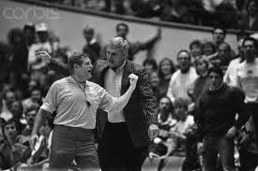
PROCEDURES
Do NOT get talked into a call by a coach, a spectator, a parent, etc.
As soon as the runners pass your area, raise the flag.
It is better to have a bad “no call” than the wrong person getting disqualified.
Make sure you got the right relay team or runner that should be disqualified.

Slide 15

PROCEDURES
We rarely have coaches get into arguments with the umpires.
They normally come storming into the press box.
However, they know that the referee makes the final decision and can over rule the head umpire if there is a misapplication of a rule (which means there was some technicality forcing a loophole).

Slide 16

SPRINTS
In the sprints, you have two things to look for
(1) Did the runner gain an unfair advantage by stepping into the inner lane on a curve, three or more times, with the left foot?
(2) Did the runner interfere with another runner?

Slide 17
HURDLES
In addition to the things to watch for with the sprints, here are the hurdle no-no’s.
(1) Drags the trail leg under the hurdles (usually with the 300 hurdles and a right lead leg). In the picture, look at the runner in lane 6 (center blue lane) the trail leg is in a position where that could happen—it must go over the hurdle, not under and around.
(2) Watch for arms going into the other lanes and blocking the other runner.
(3) Not attempting to clear the hurdles (once they knock over more than 2 hurdles, raise the yellow flag and discuss it with the head umpire)

Slide 18
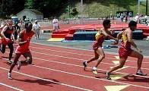
RELAYS
Some Key terms—
Exchange zones are the big triangles. The BATON must be exchanged in the zone. In our picture, this would be a good exchange since the runner is out but the BATON is in the zone.
Acceleration zone is the little triangle. In races that use them, after the race starts the runners can accelerate from that point to the exchange zone.

Slide 19
RELAYS
The baton must be handed off, not thrown.
The incoming runners must stay in their lane until they are excused by the umpire.
For the 4 X 400m Relay, the incoming runners should run a straight course then exit when clear to do so to the INSIDE.

Slide 20
4 x 100 meter relay
START—White Line
EXCHANGE ZONES--yellow
ACCELERATION ZONE—yes
Start and finish in lanes

Slide 21

4 x 200m relay
START—Black line (4 turn stagger)
Start and finish in lanes
Exchanges 1 & 2—black
Exchange 3—yellow
Acceleration zone—yes
NOTE: Don’t let the 4th runner on the track until the first exchange is long over

Slide 22
4 x 400 meter relay
START—Blue Line (3-turn stagger)
First runner stays in their lane the whole way
Exchange—blue triangles (no acceleration zone)
2nd runner cuts in at the break line by 300m hurdles start
2nd and third exchange, yellow triangles
Wild Card finish

Slide 23
4 x 800 meter relay
Waterfall start
Each runner does two laps
Exchange—yellow
No acceleration zone
Wild Card Finish

Slide 24
800 meter sprint medley
Start—White line (2-turn stagger)
100-100-200-400
100-100 exchange and 100-200 exchange—just like the 4 x 100m relay (yellow with acceleration)
200-400 exchange—yellow with acceleration zone
400 runner gets the baton in their lane then cuts in.
Wild Card Finish

Slide 25
1600 meter sprint medley
Start—white line (2-turn stagger)
200-200 Exchange (same as 4 X 100 m relay—yellow triangles)
200-400 exchange (yellow triangles with acceleration zone) 400 runner gets baton in lane then cuts in
400-800 exchange—yellow triangles
Wild Card Finish

Slide 26
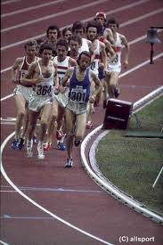
DISTANCE EVENTS
We use a waterfall start—if numbers dictate a double-waterfall start.
Runners in the outside box cut-in at the green break line
Basic rule—if they impede another runner it is a violation
Basic rule—if they run three times on the inside of the lane line—it is a violation.

Slide 27
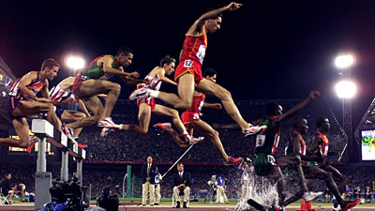
STEEPLECHASE
Same as the distance events for infractions
They must clear the barriers

Slide 28
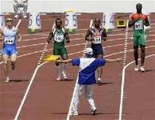
FALSE STARTS
Umpires have nothing to do with the start of the race—just to be clear
However, if there is a false start—we don’t wan the runners to go sprinting down the track unnecessarily.
If there is a false start, go out to the center lane and let the athletes know it has been a false start. For safety sake, they should sprint 20m or so before being stopped—but, that is it
Some kids are so focused that they don’t hear the recall gun and I have seen athletes go 100m around the curve before being stopped.

Slide 29

UNIFORM RULES
At our meets, the staging clerk will deal with all uniform, jewelry, and equipment issues.
We want you to focus on the race at hand and deal with any infraction calls you are suppose to make.

Slide 30
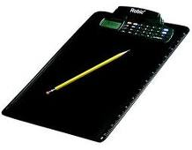
FORMS
I will have plenty of forms for the head umpire in a binder located at the finish line.
All of the rules are clearly outlined—so, we don’t need a lot of description—just a few check marks and the location of the infraction.
As the referee, I will review the form and notify the coach. It is best that the umpires don’t talk to the coaches.

Slide 31
MYTHS
Once you raise the yellow flag, it is an automatic disqualification.
FALSE
That means the umpire believes there may have been an infraction and notifies the head umpire.
The head umpire can affirm or overrule the call
If the head umpire affirms the call, the written report goes to the referee
The referee is the only person authorized to make a disqualification

Slide 32
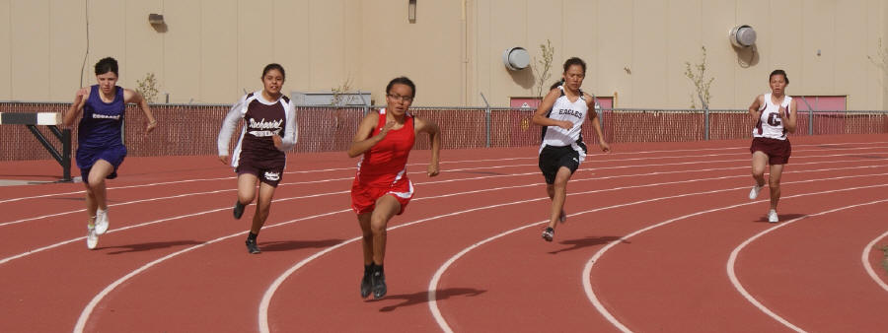
MYTHS
Once a white flag is raised, and the runners go to the next area on the track—the head umpire or referee can still call an infraction in that area.
TECHNICALLY-TRUE
However, we don’t do that here. Again, a bad “no call” is better than a bad call.

Slide 33
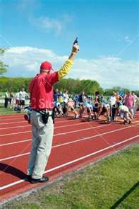
MYTHS
A field event official can rule on a running event infraction
FALSE
Same goes for timers, the starter (beyond the realm of the start itself), the announcer, etc.
The Head Finish Judge can report an infraction at the finish line such as throwing-of-the-baton (a big no-no and pretty obvious)—but only in the finish line area

Slide 34
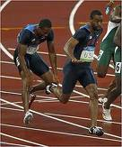
MYTH
A dropped baton is an automatic disqualification
FALSE
The runner that drops the baton has to retrieve it without any interference of the other competitors and can continue from the point of where the baton is dropped on the track.
However, the baton still has to be exchanged in the zone—so, if the runners exchange too early or too late—it is a disqualification.
If the baton is dropped inside the zone and the runner picks it up—they can continue without interfering with other runners.

Slide 35

HURDLES
Technically, it is not the job of an umpire to set hurdles.
Sophia Parrish is in charge of blocks and hurdles
But, if you want to help—it will just make the meet move along faster

Slide 36
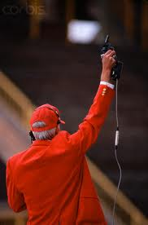
WHAT TO WEAR
Being comfortable is the key
Dress in layers
Bring a snack and something to drink
RED is our favorite color.
By wearing red, you are more easily identifiable. But, you don’t have to.

Slide 37
EQUIPMENT REQUIRED
The head umpire will get a binder, with the necessary forms, rules summations, etc.
Each umpire will need a yellow and white flag.
You can also bring a chair because a lot of the time you can be on the inside of the track and still have a good view of the race from a seated position.
I would recommend sunglasses and a hat, and layered clothing.

Slide 38
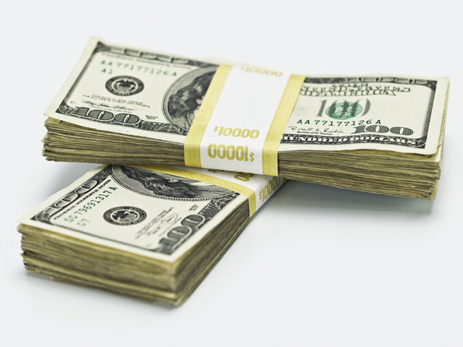
PAY RATE AND PROCEDURES
Your pay is $60 per meet.
Or, you can waive your pay and get 301 points.
Always check-in at the front gate when arriving and leaving.
After the last meet, the athletic director will submit your addendum to payroll for a 1-lump sum payment.

