Slide 1
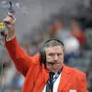
2013-STARTER
The general idea is that we want to follow the same procedures and protocols as used at the state meet.
Jim Poquette is the Head Starter at the AIA state meet, starts meets at NAU, ASU, and the Olympic Trials.

Slide 2
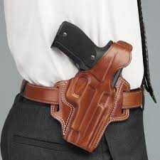
2013-STARTER
First things first—gun security and use/misuse of the gun.
The gun is not a toy—it is considered a weapon when not used appropriately and by the appropriate personnel.
Do not let students handle the guns.
Keep the gun in its holster.

Slide 3
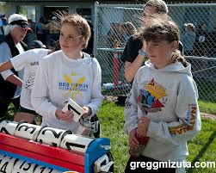
2013-STARTER
When the athletes report to the starting line, the staging clerk should have inspected all the athletes for jewelry, illegal equipment, improper uniforms, etc.
Please refer to the clerks power point for details.

Slide 4

2013-STARTER
Once they are called to set their blocks, the athletes are no longer under the clerks jurisdiction—they are under the jurisdiction of the starter and recall starter’s.
At this point, If there is a problem with illegal equipment, the AIA wants us to immediately disqualify the athlete.

Slide 5
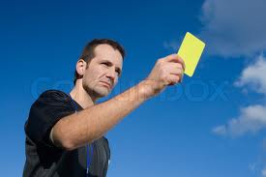
2013-STARTER
However, you also have the authority to use some discretion and let the athletes make a quick correction if it doesn’t delay the meet.
If that is the case, notify the athlete with a yellow card and subsequently tell the athlete what the issue is.

Slide 6
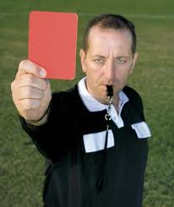
2013-STARTER
If there is an immediate disqualification, you must flash a red card.
You may give a brief explanation if you feel it is needed and appropriate.
If the athlete is ejected, notify the referee to generate the paperwork.

Slide 7
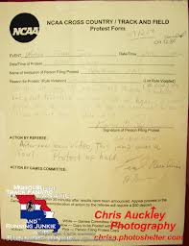
2013-STARTER
Important side note:
In football, if a flag isn’t thrown—it is not a penalty.
In basketball, if a whistle isn’t blown, it isn’t a penalty.
If a coach files an appeal because the athlete was not red-carded, we have to reinstate the athlete.

Slide 8


PRIOR TO ALL RACES
STARTER—Blow Whistle
FINISH LINE—Waive Black & White Flag to signal all is ready.

Slide 9
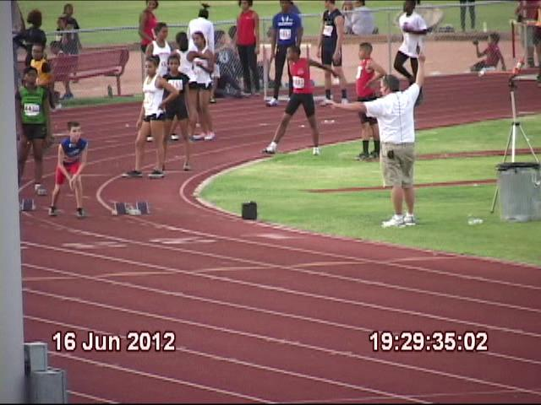
100 & HIGH HURDLES
POSITIONS
Starter—on inside of the track, about 5 meters ahead of the start line.
Recall Starter—on outside of the track, about 10 meters ahead of the start line

Slide 10

100 & HIGH HURDLES
Start command sequence
FIRST COMMAND
When the track as clear and the starter is ready to commence the command sequence…
Show green card.
“Runners set your blocks then stand behind your blocks”

Slide 11
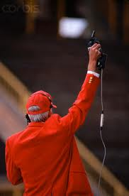

100 & HIGH HURDLES
SECOND COMMAND
Runners standing behind their blocks
Block holders in position
THIRD COMMAND
Once all the runners appear ready…
“Runners to your marks”
Right/gun hand up
Left/free hand down

Slide 12
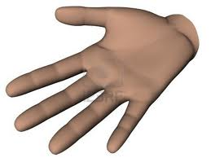
COMMUNICATION
RECALL STARTER
When lanes 1-4 are ready, display an open palm to the starter.
This indicates to the starter to continue the command sequence.

Slide 13
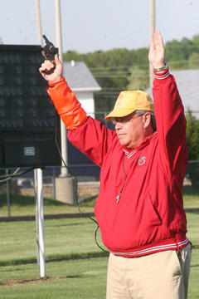
100 & HIGH HURDLES
FOURTH COMMAND
When runners appear ready…
“Set”
Don’t scream out SEEEEET
Then raise your left hand (1-1.5 seconds)

Slide 14
100 & HIGH HURDLES
FIFTH COMMAND
Fire the gun.
The time between “Set” and the gun should be no more than 2 seconds.

Slide 15
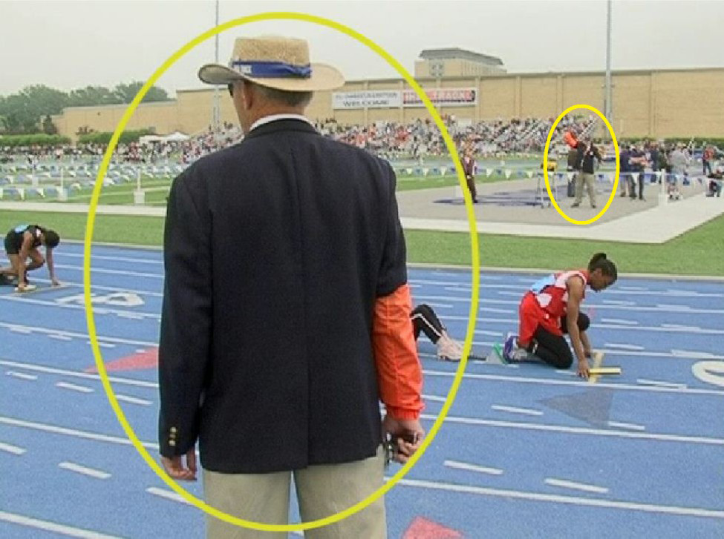
200, 400, & 300 HURDLES
RELAYS
The command sequence is the same as the 100 and 200.
Starter, inside the track lined up with lane 4
Recall Starter, outside the track lined up with lane 4—eye contact with starter

Slide 16
RACES AND RELAYS
STARTING IN LANES
STARTER—The NFHS, NCAA, USATF, and IAAF wants the starter to watch lanes 5-8
RECALL STARTER—Should watch lanes 1-4
RATIONALE: Most starters experience a blind spot over the right arm & gun.

Slide 17
IF THERE IS A FALSE START
RECALL STARTER
Gun is in right hand, at your side.
Fire the gun
Inform the starter.
Walk to the lane and flash a RED card.
Once that athletes leaves, walk lanes 1-8 displaying a GREEN card.
STARTER
Fire gun
Consult with recall starter
Avoid any verbal contact with the offending athlete and/or coach.
Recall starter displays appropriate cards.
Resume start sequence when ready.

Slide 18
WHEN TO USE A YELLOW CARD
Athletes not responding to instructions.
Athletes being unsportsmanlike
Athletes delaying getting to set position.
Again, if possible—the recall starter should flash the cards.

Slide 19
WHEN TO USE A GREEN CARD
Slipped Blocks
Bad gun shell
A distraction from the crowd
A fall in the first 100m of a distance race.

Slide 20

DISTANCE EVENTS
STARTER—positioned on the inside of the track 5 meters ahead of starting line.
RECALL STARTER—positioned on outside of the track at break line—near 300m hurdles start

Slide 21
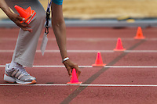
RECALL STARTER—DISTANCE EVENTS
PRIMARY TASK—If a runner falls prior to the break line—recall the start (fire gun).
SECONDARY TASK—assist umpire at break line—notify head finish judge if a runner breaks too early.
NOTE: Make sure cones are in place, if needed.

Slide 22
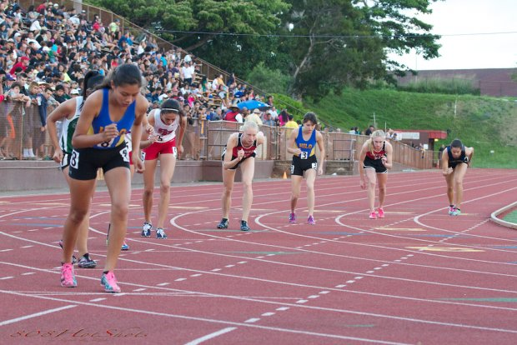
800M start
GREEN LINE
Runners stand 3 steps behind the line
“on your marks” runners step up to the line.
When runners are set, fire the gun

Slide 23
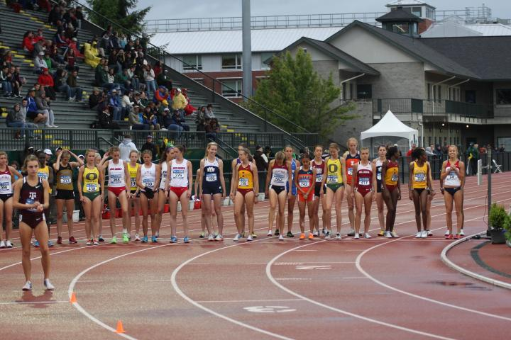
DOUBLE WATERFALL
1600—seeds 1-16 on first waterfall at finish line
Seeds 17-24 on second waterfall – lane 5
Cones should be placed on line 5 every ten meters to the break line

Slide 24
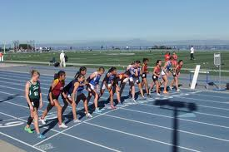
DISTANCE EVENTS
Waterfall Start
Runners take 3 steps back
“on your marks” advance to the line
When the runners are set, fire the gun

Slide 25
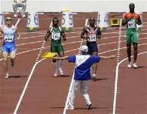
FALSE STARTS
After a false start is indicated, umpires should walk-out onto the track to ensure runners don’t keep on running

