Slide 1
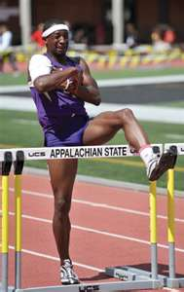
UMPIRES hurdle infractions
NFHS rule 5-13-2a
Does not attempt to clear each hurdle

Slide 2
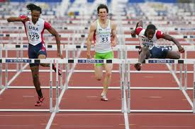
UMPIRES hurdle infractions
NFHS rule 5-13-2-b
Deliberately knocks down a hurdle

Slide 3
UMPIRES hurdle infractions
NFHS rule 5-13-2c
Advances trail leg below the hurdle (watch for right legged hurdlers in the 300m hurdles)

Slide 4
UMPIRES hurdle infractions
NFHS rule 5-13-2d
Runs in hurdle not in the assigned lane

Slide 5
UMPIRES hurdle infractions
NFHS rule 5-13-11e
Runs around the hurdle

Slide 6
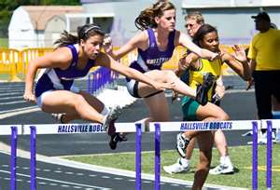
UMPIRES hurdle infractions
NFHS rule 5-13-11f
Impedes another athlete
This is especially common with the arms

Slide 7
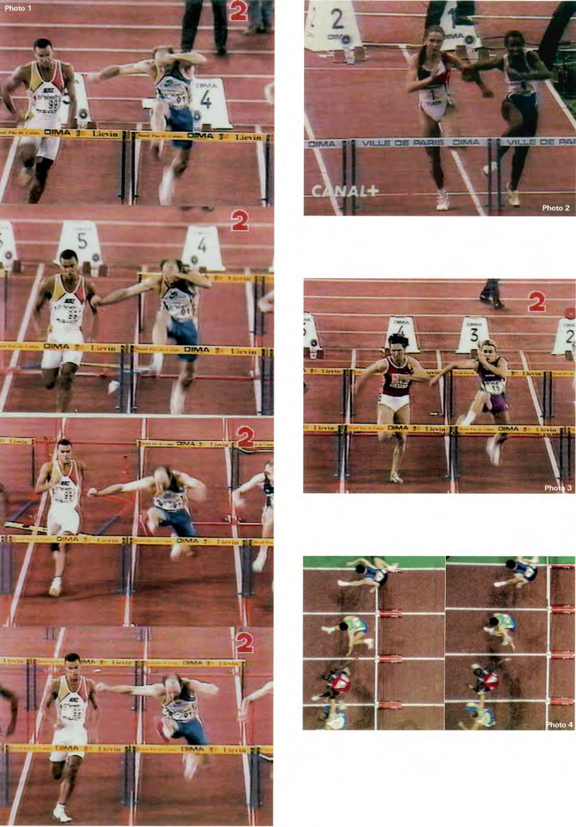
Examples of impediment

Slide 8
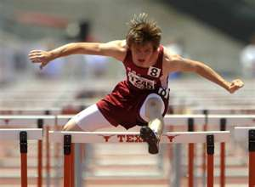
UMPIRES hurdle infractions
The athlete must keep his/her hands inside their own lane.
NOTE: Until they impede another runner, it isn’t a violation.

Slide 9
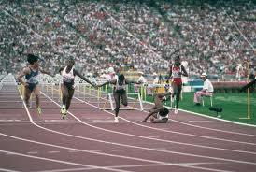
UMPIRES hurdle infractions
NOTE—especially with the last hurdle—athletes can finish the race after falling – as long as each hurdle was attempted

Slide 10
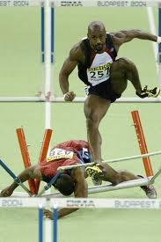
UMPIRES hurdle infractions
If an athlete interferes with another athlete—even if it is the result of a fall – it is interference.
The offended athlete has the right to ask for a re-run (the offender is disqualified)

