Slide 1
SETTING UP THE DISTANCE EVENTS
The steeplechase and 3200m run should just be one heat for the boys, and one heat for the girls. However, if we can run them together we will
In the 1600, the top twenty-four (24) athletes should be in the first heat, and all others in the second heat.
If there are less than 10 in the second heat, move seeded runners 21-24 to the second heat from the first heat.

Slide 2
DISTANCE EVENTS
If there are fewer than a total of 20 boys and girls—then we will combine them for a race.
If we do combine—have someone from a big M on the boys pull-tags (stickers).
They will go through the finish line and be timed as one race.
We will let the computers sort them out by gender.

Slide 3
DISTANCE EVENTS
If we do combine, we put the boys on the main waterfall and the girls on the second waterfall (lane 5).

Slide 4
DISTANCE EVENTS
In the distance events, we will use hip numbers.

Slide 5
DISTANCE EVENTS
Remind the runners that they may not leave the track when finished—until they are dismissed.
If they lose their pull-tag during the race, they will have to give their name to the head finish judge.

Slide 6
Notice she has a pull-tag (sticker) just below her left shoulder
Make sure all of the runners start with one.

Slide 7
As the athletes finish
The head finish judge will keep the athletes in correct place order and determines the official order of finish (this may change after further review of the Lynx or video pictures).

Slide 8
After they finish
The recorder will have the athletes hand over their pull-tags and place them on the finish line sheet in correct place order.
The recorder should be standing at the end of the straight away.
Have the runners walk/jog to the recorder.
Keep reminding the runners to stay in order.

Slide 9
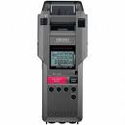
TIMING THE DISTANCE EVENTS
The head timer will use the printable stop watch and time by place. The assistant timers can use regular stop watches and get the first 8 or so.

Slide 10
SPLIT TIMES
The head timer will also read aloud the athletes split times. Once the lead runners are on their last lap, no other split times are read.
Split times are the times every time they cross the finish line.
This is important for most distance runners.

Slide 11
LAP CALLER
The HEAD FINISH JUDGE will serve as the lap caller.
Five meters in front of the finish line, both with fingers and a loud voice, let the runner(s) know how many laps are remaining
In case of a lapped runner, say something like (Blue—2 laps, yellow—3 laps).
As they finish—remind the runners to stay in order so the finish line recorder has them in the correct order.
The HEAD FINISH JUDGE makes the call on close finishes—he determines the place order (the Lynx camera may overturn that later—but, at that point in time it is official).

Slide 12
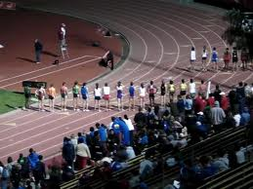
STARTING DISTANCE EVENTS
We use a waterfall start. If the field is big enough, we will use a double-waterfall start.
A double-waterfall is from lanes 5-8 and they cut in at the green break line by the 300m hurdles start.

Slide 13
STARTING THE DISTANCE EVENTS
Once the last runner has crossed the line from heat 1, we can call the next heat to the track.

Slide 14
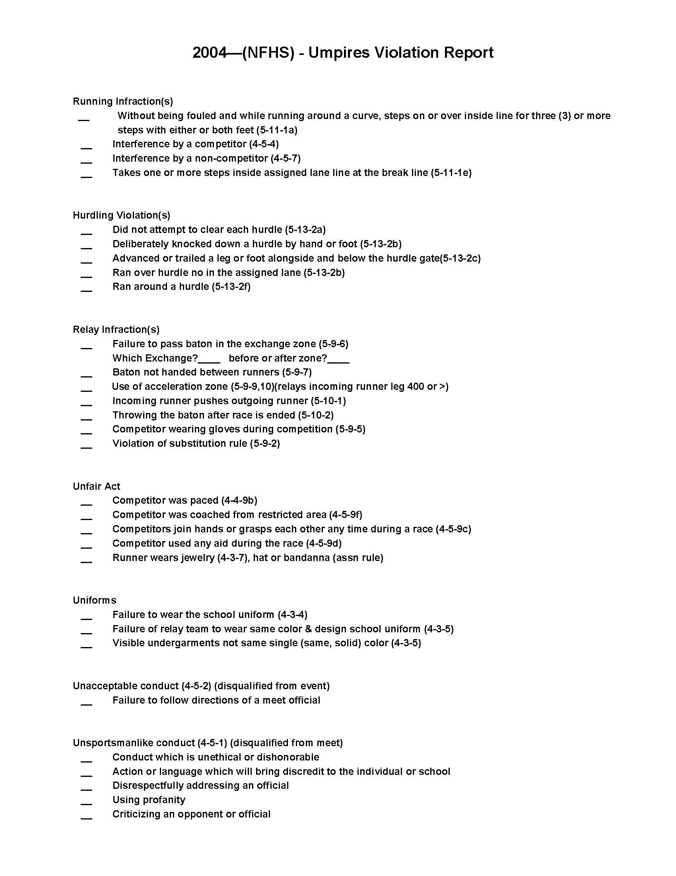
INFRACTIONS
If an umpire observes an infraction, the form is quickly filled out and given to the recorder.

