Slide 1

Bullpen & Staging Clerks
POINT OF EMPHASIS
The AIA wants us to run our meet as closely as possible to the state meet.
RATIONALE: Several issues came up last year at the state meet that could have been avoided if those coaches and/or athletes been exposed to procedures similar to those at the AIA during the regular season.

Slide 2
AIA Sports Advisory Committee
Minutes—May 29, 2012
The AIA wants us to:
The committee requested that the Executive Board know that even though we do not want to see kids miss out on opportunities, however, it is the coaches responsibility to enter their athletes, report correct results, and meet directors are required to submit correct results. The term “tough love” was used to describe the importance that coaches are required to follow allprocedural requirements.
Use bullpen for check-in.
Start Crew should follow the command sequence.
Use Green, Yellow, and Red cards
3-turn stagger for 4 X 400m Relay
1-turn stagger for 800

Slide 3
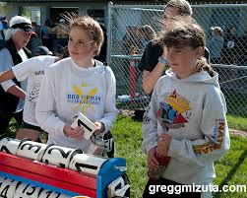
TRACK EVENTS FLOWCHART
STEP ONE
Bullpen Clerk
Athletes check-in to the Bullpen Clerk
Hip numbers are given out
Any changes to heats and lanes are made here, not at the starting line
Instructions are given to the athletes here, not at the starting line

Slide 4

TRACK EVENTS FLOWCHART
STEP TWO
Staging Clerk
Any changes in heats and lanes will be given to the staging clerk.
The staging clerk will get the athletes set in their correct heat and lane.
The staging clerk will not permit anyone to compete in illegal uniform, jewelry, etc.

Slide 5
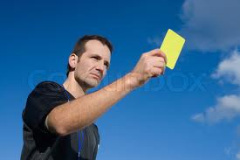
RUNNERS ILLEGALLY EQUIPPED
CORRECT PROCEDURE
Staging Clerk
The staging clerk should stand in front of the athlete and raise a yellow card.
Then, the staging clerk should tell the athlete what the problem is and provide a minute to have the situation resolved.

Slide 6
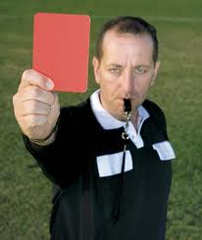
RUNNERS ILLEGALLY EQUIPPED
CORRECT PROCEDURE
Staging Clerk
If the athlete does not address the problem prior to the runners being called to the starting line, the staging clerk will flash a red card, making it clear the runner is Disqualified.

Slide 7

RUNNERS ILLEGALLY EQUIPPED
CORRECT PROCEDURE
Staging Clerk
Once the procedure is corrected, then staging clerk flashes a green card.
Once all the runners are clear, the staging clerk turns them over to the starter.

