Slide 1

DISCUS
BEFORE the event, the Head Judge must make sure everything is in order and the event is ready to go.

Slide 2
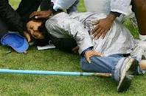
DISCUS
Above all else, remember the officials should consider safety their highest priority.

Slide 3
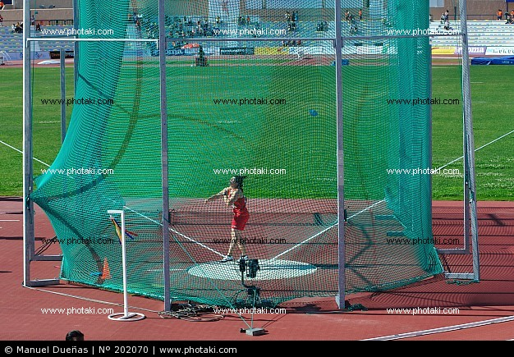
DISCUS
1 HOUR PRIOR TO THE START OF THE EVENT:
A—Sweep off the ring
B—Secure the area with flagging or cones
C—Make sure you are properly equipped

Slide 4

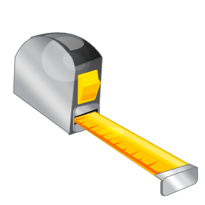
EQUIPMENT NEEDED
Binder
Tape Measure (100m)

Slide 5
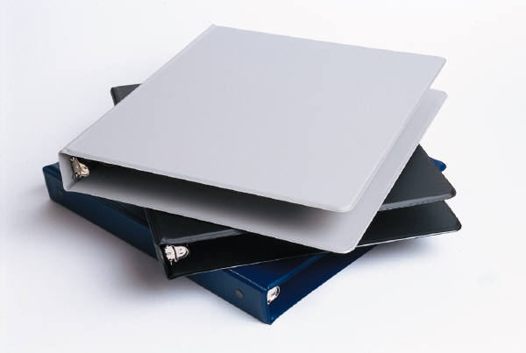
BINDER
The binder will have the following:
(1) Flight Sheets
(2) Pencils
(3) Radio – usually we don’t use these, however
(4) Extra forms
(5) Clipboard

Slide 6

ALSO NEEDED
Broom
If the ring is damp, you may need to get some towels to keep the ring dry

Slide 7
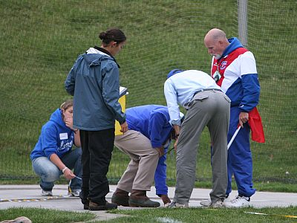
STAFFING
Head Judge (#1)
Assistant Judge (#2-Impact Area)
Assistant Judge (#3-Impact Area)
Assistant Judge (#4-Ring)
Recorder

Slide 8
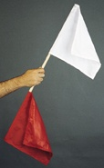
HEAD JUDGE #1
Rules on all trials
It is a foul…
Trial not attempted after 1 minute of being called
Fails to pause before throwing
After starting the attempt touches outside the circle or top of the band
Discus lands outside the sector area
Discus hits the cage
Thrower not under control when exiting the ring
Leaves the ring prior to the head judge announces MARK
Does not exit the back half of the circle
The mark is not beyond the minimum measuring mark.
If the throw is a FOUL the head judge raises his/her RED FLAG
Note: The NFHS does not recommend yelling FOUL.

Slide 9
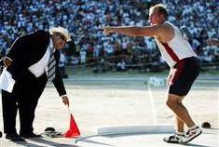
DISPUTES
If an athlete disputes a foul, briefly explain the call (such as stepping out of the ring) and move on.
If the athlete continues to complain, show a yellow card.
If the athlete still continues, show a red card and eject the athlete

Slide 10

UNIFORM RULE
BEFORE an athlete enters the ring, make sure they are legally equipped (especially the uniform).
Say something like, “Remove the ear ring” and give them a minute to do that.
If they don’t correct it and enter the ring, it is a FOUL.

Slide 11
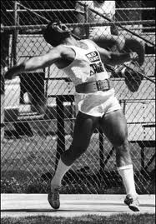
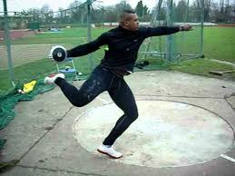
POINT OF EMPHASIS
Legs and arms may be outside of the ring so long as they don’t touch the ground.
Belts may be worn, but no weights attached. No gloves may be worn.

Slide 12
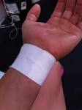

ATHLETIC TAPING
Wrist only… Okay
Taping of hand is illegal unless to cover an open wound

Slide 13
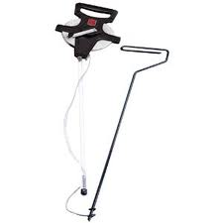
DISCUS JUDGE #2
The #2 judge has the tape measure secured to the measuring stick and marks the impact spot immediately after landing.
NOTE: Stand outside the sector while waiting
NOTE: Maintain eye contact with the throwing circle

Slide 14
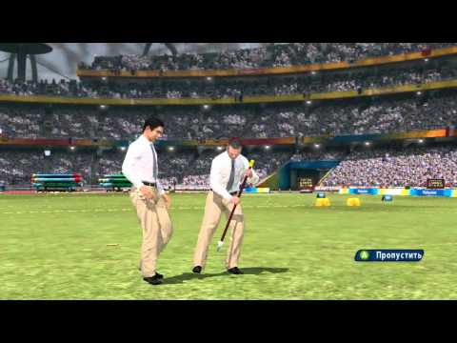
DISCUS JUDGE #3
Immediately after the throw, confirm the spot of impact as determined by the #2 judge.
Once the measurement is taken, drop the discus off outside the sector line.
Do NOT allow the throwers to enter the impact area.

Slide 15
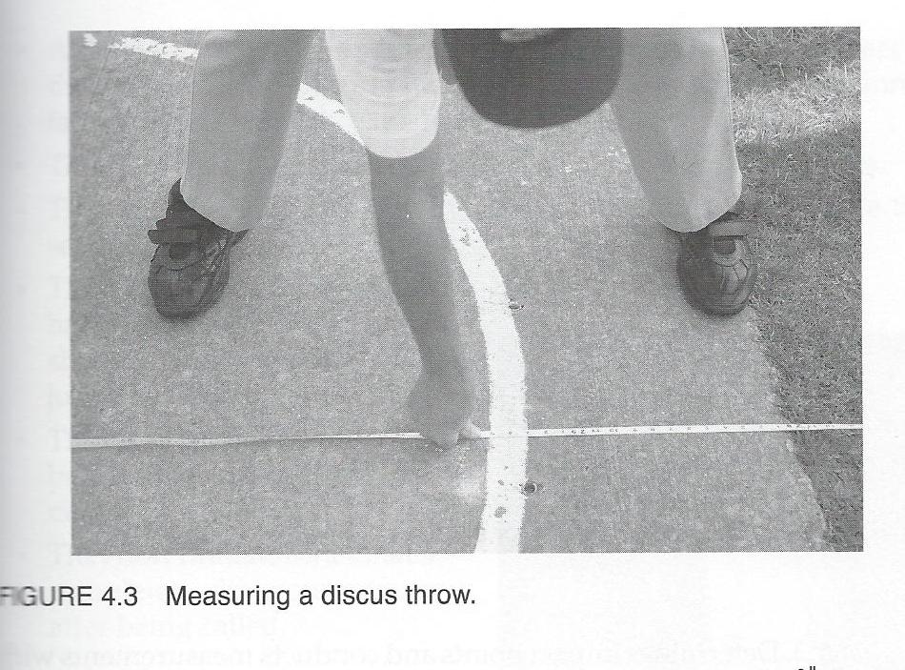
JUDGE #4
Pulls the tape through the ring to ensure the trial is measured correctly.
#4 will be at the back of the ring and pull the tape over the center point of the circle
The head judge will then measure the mark at the front of the ring

Slide 16

RECORDER
Will call up the athletes.
UP—meaning the about to throw
ON DECK—the next thrower
ON HOLD—The one after the one deck person
Immediately after the throw, records the result
The mark should be recorded to the nearest lesser inch.
180 – 01.75 should be read as 180 feet, 1 inch.
It is recommended that the recorder is seated at a desk behind the discus ring.

Slide 17
REVIEW OF THE PROCESS
(1) Recorder calls the athlete to the ring. The athlete has 1-minute to make an attempt.
(2) After the implement has made contact with the ground, the head judge determines if it is a good throw (white flag) or foul throw (red flag).
(3) If legal, then the head judge announces MARK
(4) The thrower then, and only then, may leave the ring through the back half of the ring.
(5) If the athlete does not exit the ring properly, the head judge raises the red flag and announces foul
(6) If the mark is legal, the mark is then measured.
(7) If the mark is short of the hog line, then it is recorded as a foul.
(8) If the mark is good, then the distance is announced in English measurement to the lesser inch.
(9) The recorder writes in the distance and announces it back to the head judge for confirmation.
(10) The process is then repeated for the next thrower.

Slide 18

WARM-UP SESSION
The recorder calls up the first, then subsequent flights.
The head judge will give that flight their final instructions
Each athlete should have two (2) legal implements to warm-up with.
Remind the athletes about all safety procedures
The time limit for warm-ups is 15 minutes.

Slide 19

FLIGHTS
Flights will be set-up already on the score sheets.
The head judge may make adjustments as needed.
Start at the top, giving each athlete their first throw, to the bottom of the list
Then do the second round, then third round
Be sure to write-in the throw measurement in METERS.

Slide 20

FINALS
The top eight (8) advance to the finals.
If there is a tie for the 8th spot, both advance.
The #8 athlete goes first, then #7, and so on.
Run the finals just like a flight.

Slide 21

PLACEMENT
The best attempt on the day for each athlete determines the final placement.
The computer will sort this all out—so, don’t be too concerned about this.

Slide 22

UNUSUAL OCCURANCES
If something unusual happened, such as a sportsmanship issue, please note that on the appropriate form and turn that in with the results to the timing tent.

Slide 23
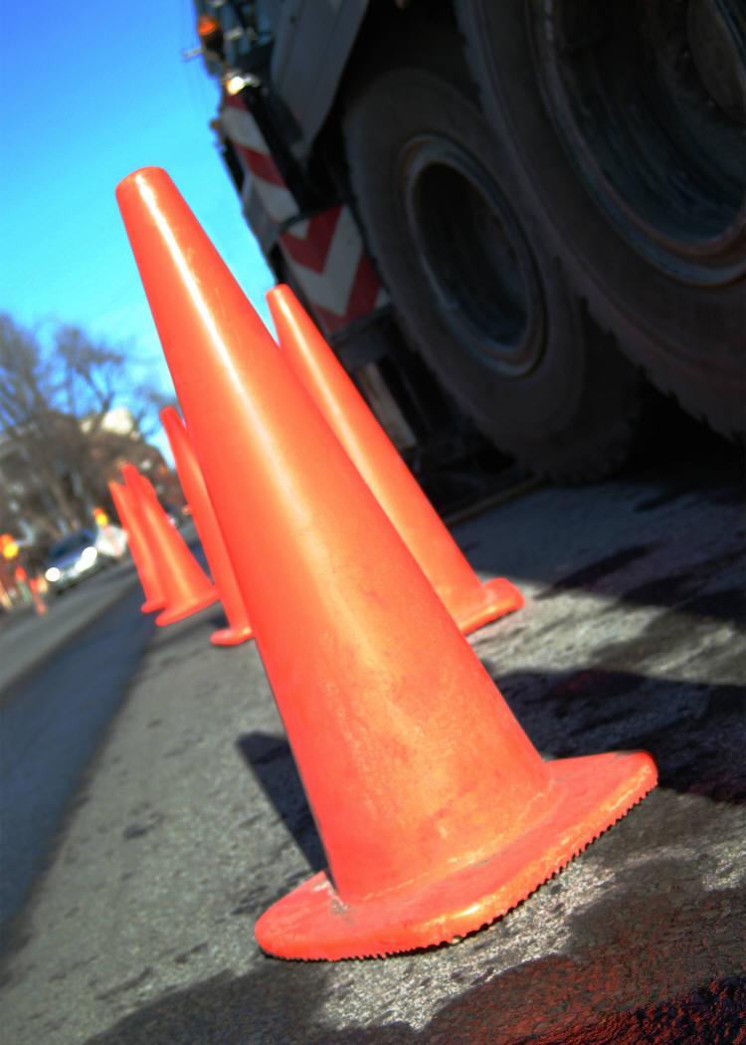
CLOSING DOWN THE FACILITY
When leaving the venue, place a cone in the center of the ring.

