Slide 1
HIGH JUMP
The rules are pretty basic
The biggest thing is to record the attempts onto the score sheet properly

Slide 2
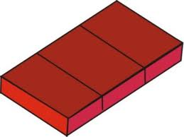
HIGH JUMP
The equipment is pretty straight forward.
First, there is a PIT

Slide 3

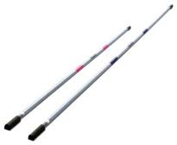
HIGH JUMP
Standards Cross-Bar

Slide 4
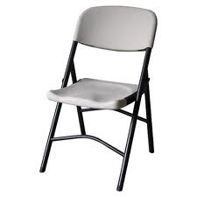
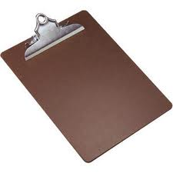
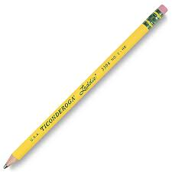
HIGH JUMP
Chair Clipboard Pencil

Slide 5

HIGH JUMP
RED AND WHITE FLAG (yellow for running events)

Slide 6
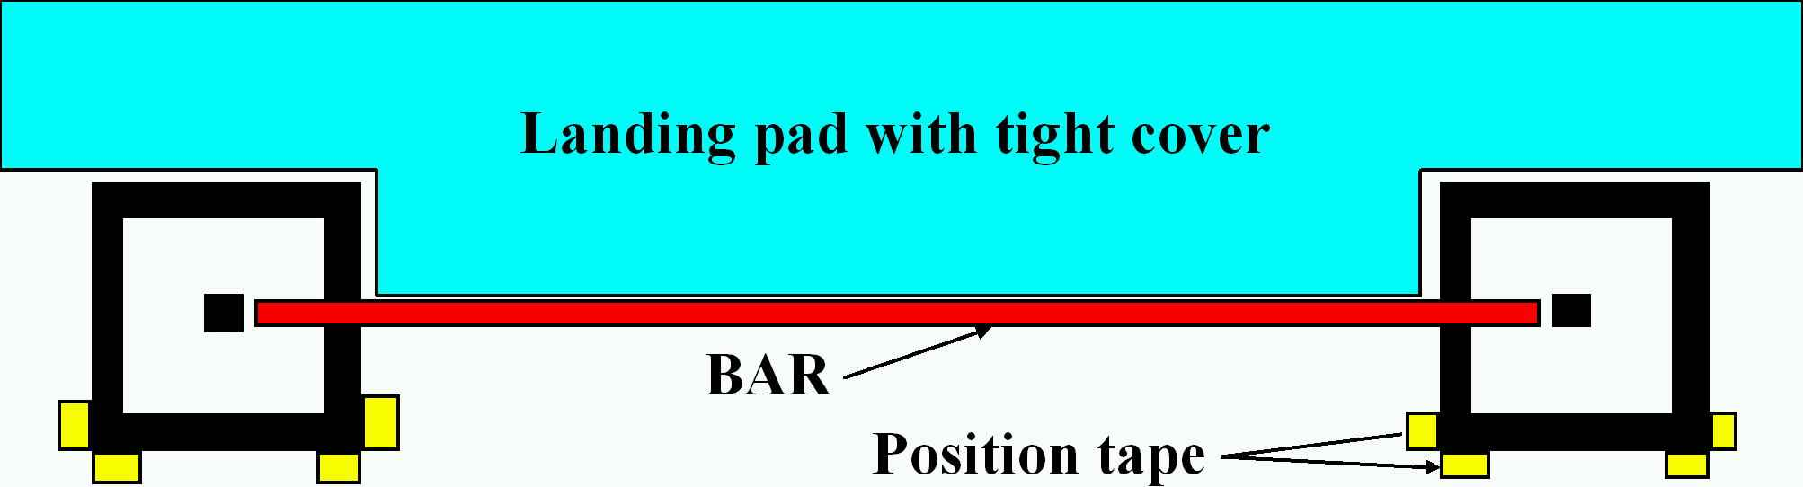
HIGH JUMP
First, make sure the pit, standards, and cross-bar are set-up properly.

Slide 7
HIGH JUMP
The cross-bar should be at the leading edge of the pit.
Put tape down on the base of the standards—they don’t move once the competition starts.

Slide 8
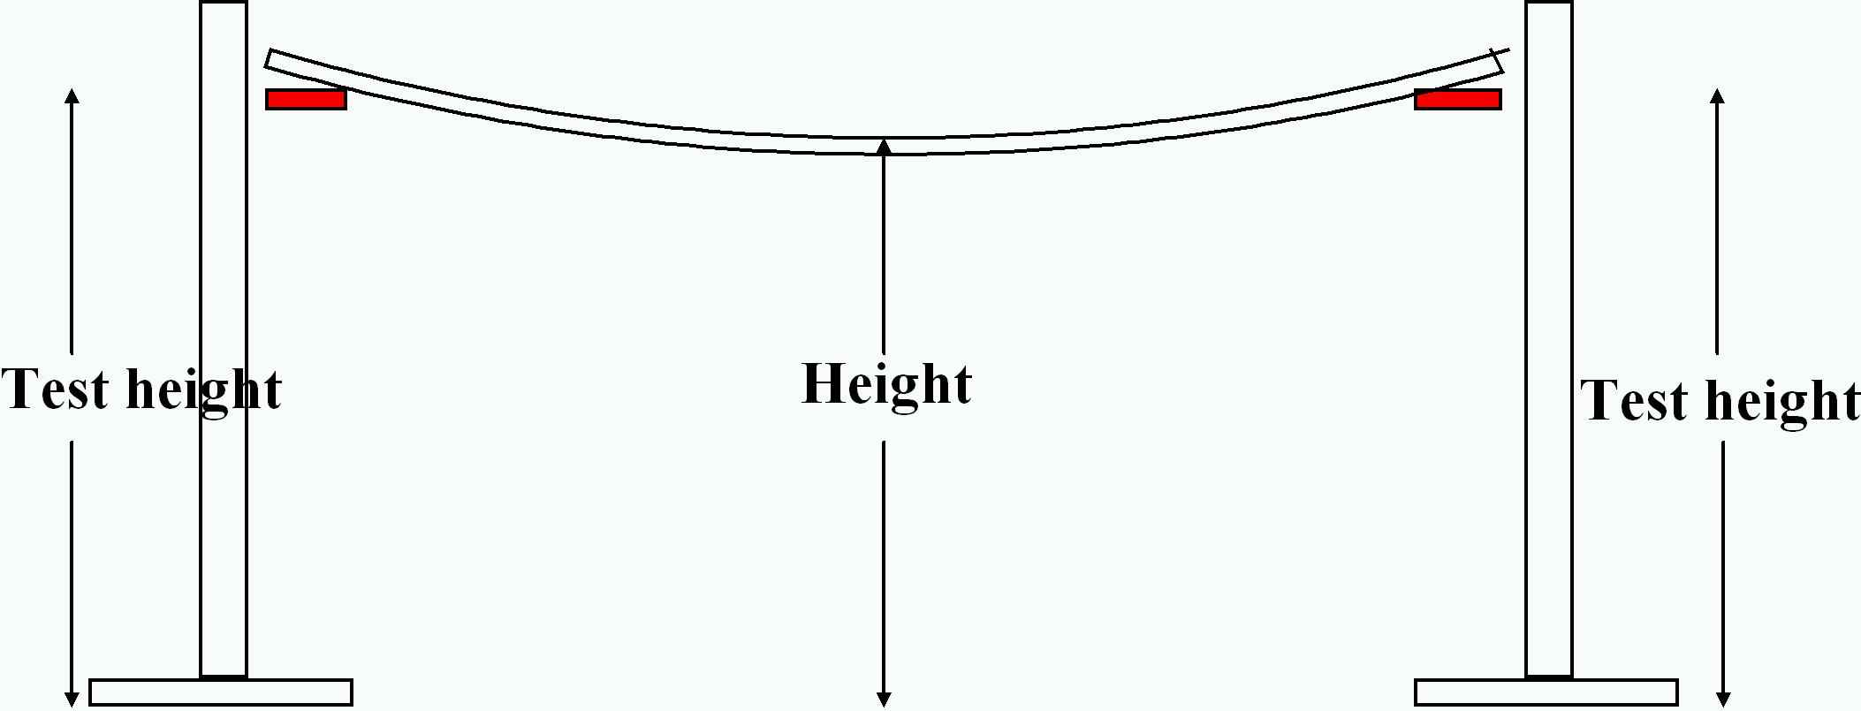
HIGH JUMP
Second, measuring the height has to be consistent. Measure the height at the middle of the cross-bar and to the top of the bar.

Slide 9
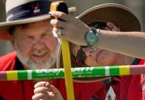
HIGH JUMP

Slide 10
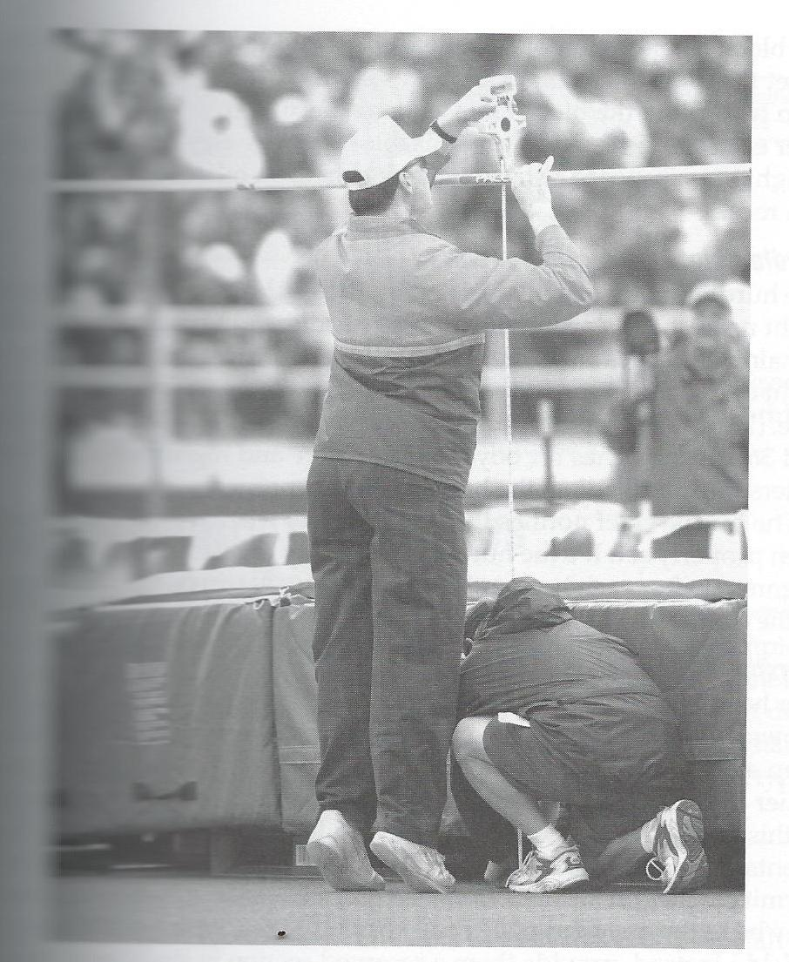
HIGH JUMP

Slide 11
HIGH JUMP
The nuts and bolts of the competition.
Each athlete can start at any height they wish, but they aren’t credited with a successful attempt until they clear an actual height.
Once an athlete has three (3) consecutive misses, they are eliminated from the competion.

Slide 12
HIGH JUMP
Each time an athlete PASSES on a height, put in a P on the score sheet.
Each time an athlete MISSES on a height, put an X on the score sheet.
Each time an athlete has a successful attempt, put an O on the score sheet.
HINT: O FOR OVER.

Slide 13
HIGH JUMP
A miss is usually pretty obvious, but here are the rules.
(1) If you think the athlete caused the bar to be dislodged (not the wind), then it is a miss.
(2) If the athlete takes off on two feet, it is a miss.
(3) If the athlete doesn’t make an attempt within 2 minutes of being called, it is a miss
(4) If the athlete makes an attempt not being properly equipped, it is a miss (for instance, wearing jewelry).

Slide 14
HIGH JUMP
Every year, someone tries to bring up some old “field day” rule where if an athlete leaves the pit and the cross-bar is not dislodged until after he/she leaves the pit—it is not a miss.
The bottom line it is the judgment of the official.

Slide 15
HIGH JUMP
Here is the process, step-by-step. We actually bend some rules in the interest of safety—so if anyone says something like “that’s not the rule”
You say, “in the interest of safety, we are doing it this way”

Slide 16
HIGH JUMP
Before the event starts, give the athletes 15-20 minutes to get their steps down.
Remove the cross-bar
The athletes may place tape markers on the apron.
No cones, tennis balls, etc.

Slide 17
HIGH JUMP
As the athletes check-in – write in their opening height for the event on the score sheet.
Write in three P’s at the heights they are not jumping at.
When it is time to begin, place the cross-bar at the opening height.
It will be noted on the score sheet

Slide 18
HIGH JUMP
Have each athlete that is jumping at the opening height take their first jump in order.
Announce who is “on deck” and “ON HOLD”
Write in an X for a miss and an O for a make.
Anyone not making the height, give them a 2nd try.
Anyone not making the height, give them a 3rd try. If they miss on their third try, they are out.

Slide 19
HIGH JUMP
When an athlete has climbed out of the pit ….
DO NOT say anything
If it was a successful attempt, raise the WHITE flag.
If it was a miss, raise the RED flag.
Write either X or O on the score sheet.
Then, call up the next athlete.

Slide 20
HIGH JUMP
Before raising the height of the bar, give the competitors 3 minutes or so to do run-throughs without the bar—with our winds, it is a safety issue. We have kids jump and miss the pit because of the wind.
Announce the order once again.
Give each athlete at that height three attempts like you do opening height.
Once we are down to one competitor, that competitor can declare which height to compete at.

Slide 21
HIGH JUMP
If there are any ties, we can break them up at the press box.
If there is a tie for first place that can’t be broken…we will have to have a jump-off.

Slide 22
HIGH JUMP
Breaking Ties (Rule 7‐3‐1, 7‐3‐2, 7‐3‐3, 7‐3‐4)
Art. 1 – A tie in a jumping event occurs when two or more competitors finish with the same height.
Art. 2 – When there is a tie at any height in the finals, places and points shall be awarded as follows:
• The competitor with the fewest number of trials for the height at which the tie occurs, which is the last
height successfully cleared, shall be awarded the higher place.
• If the tie still remains, the competitor with the fewest total number of unsuccessful trials throughout
the competition, up to and including the height last cleared, shall be awarded the higher place.
• Passed trials shall not count as misses.
• If the tie remains after applying the above:
• If it concerns first place, the competitors tying shall make one more attempt at the height at which
they failed. If no decision is reached, the bar shall be lowered in increments of 1 inch in the high jump
and 3 inches in the pole vault. If two or more of the tying contestants cleared the height, the bar shall
be raised by intervals of 1 inch in the high jump and 3 inches in the pole vault. Each competitor shall
attempt one trial at each height until a winner is determined.
Art. 3 –In the vertical jumping events, a competitor shall be credited with his/her best achievement if it
occurs in a jump‐off for first place.

Slide 23
HIGH JUMP
By rule, the bar is not lowered.
If an athlete is excused to another event, that athlete will obviously jump out of order.
When it comes time to raise the bar, wait five (5) minutes—raise the bar, and credit that athlete with a PASS.
Again, the real rule is that we should wait until the other event has concluded + five minutes.
If we did that, we wouldn’t get done before midnight.

Slide 24
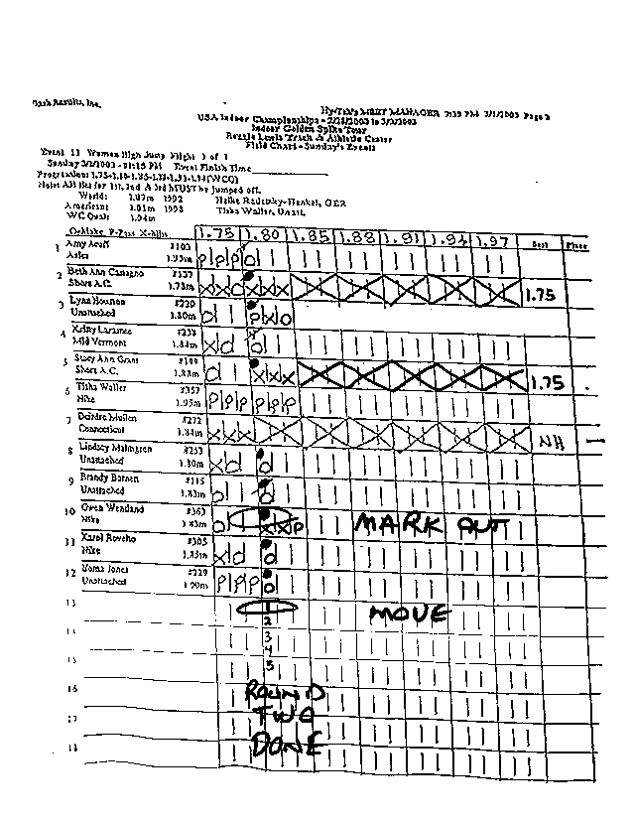
HIGH JUMP

Slide 25
HIGH JUMP
GIRLS PROGRESSION
4-00, 4-02, 4-04, THEN ONE-INCH
BOYS PROGRESSION
5-00, 5-02, 5-04, THEN ONE-INCH

Slide 26
HIGH JUMP
One final note---
Do not lower the bar during the competition except for a tie-breaker at first place.
If an athlete leaves for another event, tell them that you will wait no more than 5 minutes before raising the bar.

Slide 27
HIGH JUMP
If an athlete comes back and left at 5-0, was gone at 5-2, and now at 5-4---they technically passed at 5-2 and have to jump at 5-4.

Slide 28
HIGH JUMP
COACHES BOX
Each competing school may have one (1) coach in the box.
The coach must stay on the pavement and not be on the football field or track
Filming is permitted, but may not be viewed by the athlete.
No cell phones, ipods, etc.
Coaches may not interfere with the officiating.

