Slide 1

LONG & TRIPLE JUMP
PERSONNEL
Head Judge
Recorder
Measurement (Pit)
Measurement (Board)
Raker

Slide 2
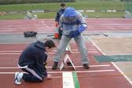
LONG & TRIPLE JUMP
HEAD JUDGE
Rules on all trials (determines if the jump is good or a scratch)
Make sure the facility is safe and the event runs smoothly
Helps the assistants
Calls out-loud the official measurement (metric and English) for the recorder.

Slide 3

LONG & TRIPLE JUMP
RECORDER
Records the wind reading for all fair jumps
Records the measurement lesser quarter inch for all fair jumps
Writes in FOUL for all foul or scratched jumps
The recorder should be seated at the desk.
The recorder should announce back to the head judge the official distance confirming the athlete’s mark.

Slide 4
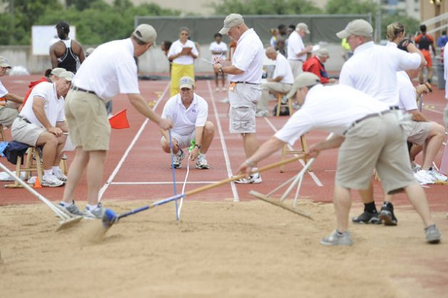
LONG & TRIPLE JUMP
ASSISTANTS FOR MEASUREMENT
One measures from the board (actually, a painted line—but we call it a board anyway)
One measures from the Pit.
If you note in the picture, they work together to pull the tape straight and tight.

Slide 5

LONG & TRIPLE JUMP
The raker(s), after the measurement, ensures that the pit is ready to go for the next jump
Do NOT rake the pit until the measurement has been recorded.

Slide 6
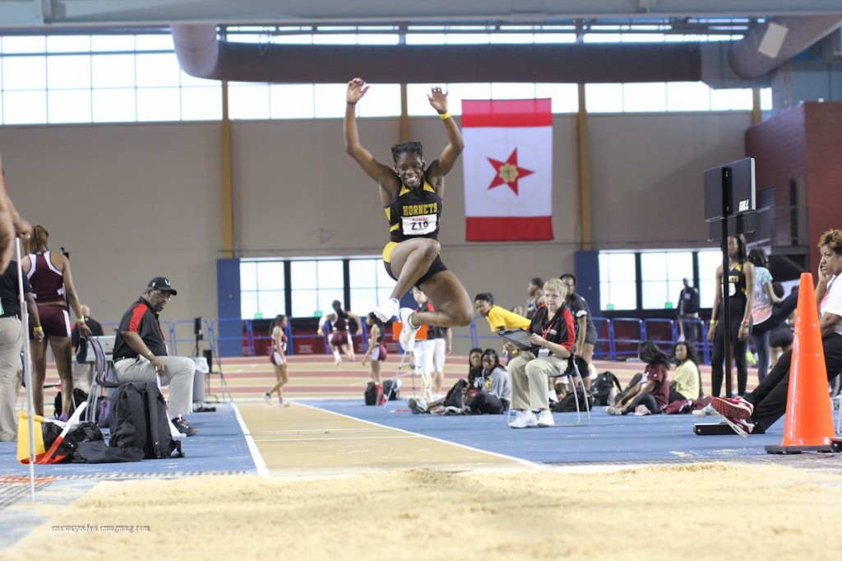
LONG & TRIPLE JUMP
COACHES BOX
Each competing school may have one (1) coach in the box.
The coach must stay on the pavement and not be on the football field or track
Filming is permitted, but may not be viewed by the athlete.
No cell phones, ipods, etc.
Coaches may not interfere with the officiating.

Slide 7

LONG & TRIPLE JUMP
WIND GAUGE
Put right next to the student desk (just to the west side of it).
A tail wind will be positive.
A head wind will be negative.
Simply hit the start button when the jumper starts down the runway

Slide 8

LONG & TRIPLE JUMP
After the warm-up is done, call the athletes over and go over the following:
Open pit format
Checking in, UNIFORM RULE, what actually is a foul or a scratch.
Measurement
4 attempts for all athletes
Make sure the time limit is well known

Slide 9

LONG JUMP & TRIPLE JUMP
Especially during the triple jump, don’t yell out FOUL until they have fully complete their jump.
Do immediately raise the red flag if they scratch.
If it is a good jump, raise the white flag

Slide 10
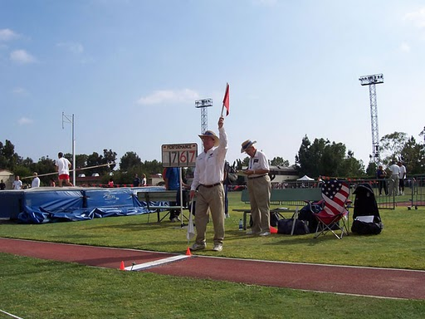
LONG & TRIPLE JUMP
This is the correct way to indicate a FOUL jump.
NOTE: The athlete can jump legally from the board, but may earn a FOUL for not making it to the pit, touching outside the pit, etc.

Slide 11
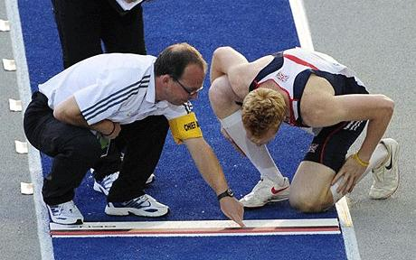
LONG & TRIPLE JUMP
DETERMING A FAIR OR FOUL JUMP
Technically, the edge of the board (painted line) NEAREST the pit is the foul line.
Jumping prior to the foul line is FAIR.
Jumping after the foul line is FOUL.
Raise the RED flag for fouls and yell scratch.
Raise the WHITE flag for fair jumps and say mark.

Slide 12
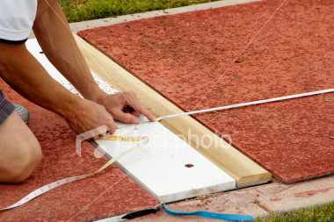
LONG & TRIPLE JUMP
MEASURING THE JUMPS
The zero end of the tape measure is in the PIT.
The measuring end is at the board.
The tape must be at a 90 degree angle to the pit and board.
Read at the front of board (nearest to the pit). See where the finger is at—the is the point of measurement.
Measure to the lesser quarter inch such as 18-00.25
Have the recorder announce back the measurement to confirm.
Record foul jumps as FOUL.

Slide 13

LONG & TRIPLE JUMP
MEASUREMENT
In the pit, the mark to measure from is the nearest indention to the board.
That will include butt and hand imprints.
Summersalts, touching outside the pit, and not reaching the pit are fouls.

Slide 14

LONG & TRIPLE JUMP
It helps to have the zero end of the tape measure have a measuring stick attached.
Just poke the stick in the ground to measure from.
Then pull the tape through the board at a 90 degree angle.

Slide 15
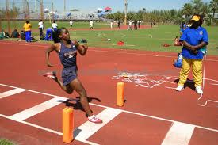
LONG & TRIPLE JUMP
Especially in the triple jump, have a cone on each side of the board the athlete is jumping from.
That way, there is no mistake of which board is used and to measure from.
The cones at the TJ board is correct.

Slide 16

LONG & TRIPLE JUMP
OPEN PIT
The pit is open for one hour (triple jump) and 90 minutes (long jump); however, the judge can extend that time if he/she feels it is warranted.
Having the kids sit around for the first 20 minutes is not a good reason.
Athletes may have four (4) attempts.
Let the computer sort out the place winners.

Slide 17

LONG & TRIPLE JUMP
The Triple Jump is a little bit more complicated.
Basically, the athlete can jump off the left foot, then the left foot again, then the right foot—or right, right, left.
The head judge has to ensure that they don’t vary from that order.

Slide 18
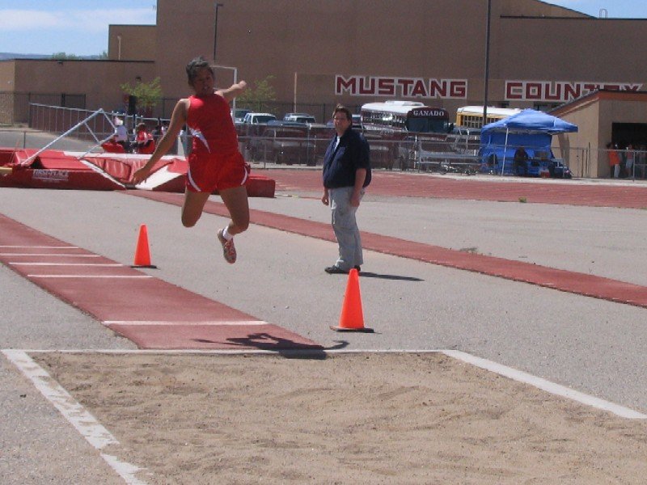
LONG JUMP & TRIPLE JUMP
Have the athlete set-up the cones from which board they will jump from in the triple.
We have boards at 20, 25, 30, and 35 feet from the edge of the pit.
We run the boys and girls at the same time since so few compete in this event.

Slide 19

LONG & TRIPLE JUMP
  EQUIPMENT NEEDED
  Student Desk
  Wind Gauge
  Clipboard, pencils, and score sheets
  Shovel and Rake
  Metric tape measures
  We will try to till the pit prior to the meet.

Slide 20

LONG & TRIPLE JUMP
UNIFORM RULES
We have to enforce these rules.
If you see a problem, flash a yellow card and explain the problem.
If an athlete competes while out-of-compliance, it is a foul.

Slide 21
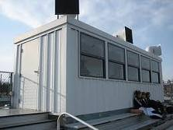
LONG JUMP & TRIPLE JUMP
After the triple jump is done, send the results up to the press box.
Give the boys in the long jump 30 minutes to warm-up then 1 hour open pit (send results to the press box)
Give the girls in the long jump 30 minutes to warm-up then 1 hour open pit (send results to the press box).

