Slide 1
JAVELIN
BEFORE the event, the Head Judge must make sure everything is in order and the event is ready to go.
1—sector roped off
2—signs posted
3—sectors lines
4—runway cleaned
5—student desk and chair for recorder
6—tape measure
7—certification kit
8—score sheets, radio, red/white flags

Slide 2
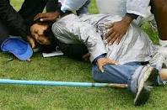
SAFETY
Above all else, remember the officials should consider safety their highest priority.

Slide 3
safety
JAVELIN COMPETITION SAFETY RECOMMENDATIONS FOR MEETS INVOLVING MEMBER SCHOOLS
1. A javelin event should not be held unless trained personnel are available to conduct the event.
Schools are encouraged to develop a plan to train officials
2. All athletes are instructed in javelin safety rules and regulations prior to being allowed to throw or
compete. After competition no additional throws are permitted.
3. A field marshal should be used to make sure no athletes or spectators enter the sector or warm-up area.
4. It is recommended that the throwing area be roped off or bright orange cones and warning signs beposted.
5. Athletes waiting to throw are made to wait well behind the throwing area.
6. All thrown javelins are retrieved by an official or coach and handed to the athlete outside the sector. A side should be designated usually the side the wind is blowing away from.
7. The head official stands in the center of the approach and placing an orange cone on the run way thus prohibiting the next competitor from throwing until the sector is clear
OFFICIALS—it is better to miss a good throw than to get hit by a javelin. The throw can be repeated—you can’t
Best to keep flights small and the area clear
Too many athetes in area is a recpe for disaster
NEVER LET JAVELIN S

Slide 4
WARM-UPS
In the javelin, the picking warm ups should be done with one pick line, going in the same direction being controlled by two officials with red flags.
All competitors should be in one straight line with an official on each end of the line with a red flag to control the progress of the pick line down the field. Every athlete should throw and then the entire line should be walked up to retrieve the implements.
No one should be allowed to throw until all the athletes have retrieved their implements and are back in the straight line behind the officials who are posted at each end of the line. The procedure should be repeated with the Officials making the decision when it is safe to throw.
The Officials should be cognizant of the remaining length of the field to keep these throws from going onto the track or into another event area. When picks are ongoing, the participants, officials and spectators should be aware that occasionally a javelin will not stick but slide.

Slide 5
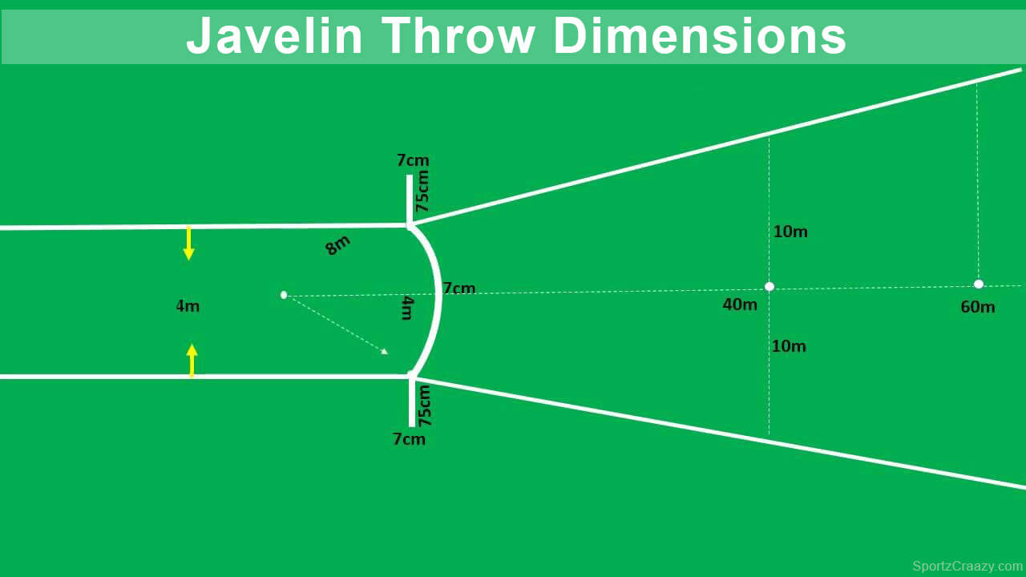
SET-UP
1 HOUR PRIOR TO THE START OF THE EVENT:
A—Sweep off the ring
B—Secure the area with flagging or cones
C—Make sure you are properly equipped

Slide 6

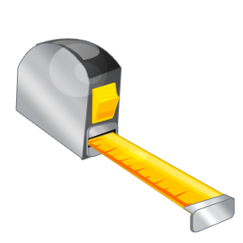
EQUIPMENT NEEDED
Binder
Tape Measure (100m)

Slide 7
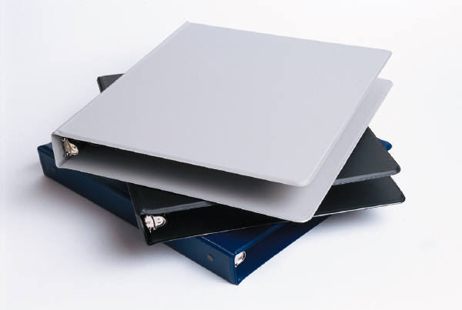
BINDER
The binder will have the following:
(1) Flight Sheets
(2) Pencils
(3) Radio – usually we don’t use these, however
(4) Extra forms
(5) Clipboard

Slide 8

ALSO NEEDED
Broom
If the runway is damp, you may need to get some towels to keep dry

Slide 9
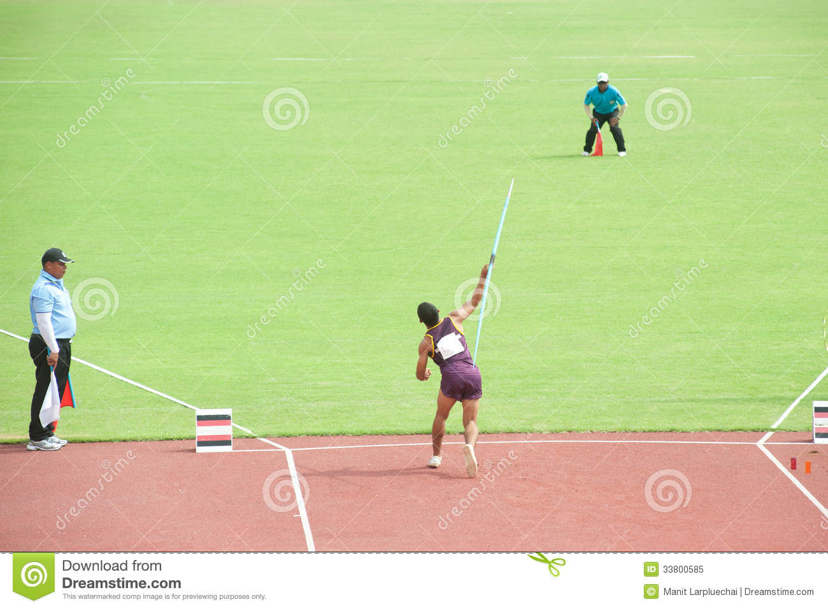
STAFFING
Head Judge (#1)
Assistant Judge (#2-Impact Area)
Assistant Judge (#3-Impact Area)
Assistant Judge (#4-runway)
Recorder

Slide 10
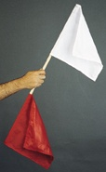
HEAD JUDGE #1
Rules on all trials
It is a foul…
Trial not attempted after 1 minute of being called
Fails to pause before throwing
After starting the attempt touches outside the runway
Lands outside the sector area
Thrower not under control when exiting
Does not hold whipchord
Leaves the runway prior to the head judge announces MARK
Taping hands or fingers
a. Makes a 360-degree turn before the javelin is released. b. Uses a delivery other than an over-arm, above-the-shoulder motion of the throwing arm. c. Throws the javelin so it does not fall within the sector line.
The mark is not beyond the minimum measuring mark.
If the throw is a FOUL the head judge raises his/her RED FLAG
Note: The NFHS does not recommend yelling FOUL.

Slide 11
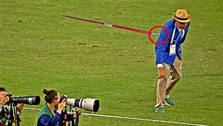
POINT OF EMPHASIS
Never turn your back to throwers
Control the warm-ups

Slide 12
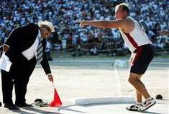
DISPUTES
If an athlete disputes a foul, briefly explain the call (such as stepping out of the ring) and move on.
If the athlete continues to complain, show a yellow card.
If the athlete still continues, show a red card and eject the athlete

Slide 13
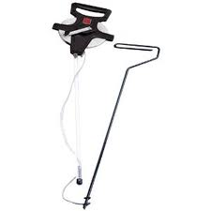
JUDGE #2
The #2 judge has the tape measure secured to the measuring stick and marks the impact spot immediately after landing.
NOTE: Stand outside the sector while waiting
NOTE: Maintain eye contact with the throwing circle

Slide 14
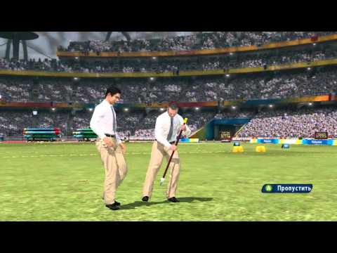
JUDGE #3
Immediately after the throw, confirm the spot of impact as determined by the #2 judge.
One the measurement is taken, drop the shot off outside the sector line.
Do NOT allow the throwers to enter the impact area.

Slide 15
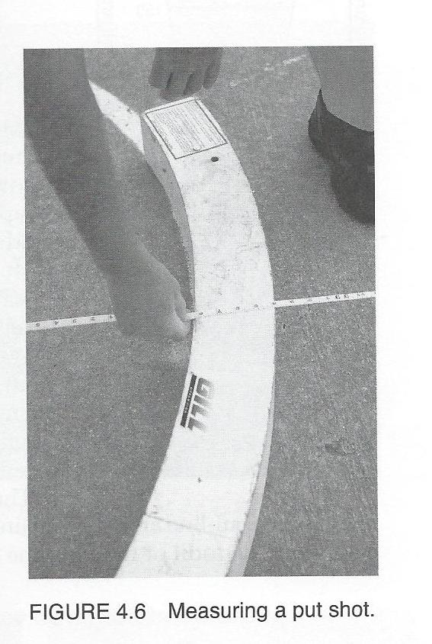
JUDGE #4
Pulls the tape through the ring to ensure the trial is measured correctly.
#4 will be at the back of the ring and pull the tape over the center point of the circle
The head judge will then measure the mark at the front of the ring

Slide 16

RECORDER
Will call up the athletes.
UP—meaning the about to throw
ON DECK—the next thrower
ON HOLD—The one after the one deck person
Immediately after the throw, records the result
The mark should be recorded to the nearest quarter inch.
28-00.25 should be announced as “twenty-eight feet, zero and one-fourth inches”
It is recommended that the recorder is seated at a desk behind the sector

Slide 17
REVIEW OF THE PROCESS
(1) Recorder calls the athlete to the ring. The athlete has 1-minute to make an attempt.
(2) After the implement has made contact with the ground, the head judge determines if it is a good throw (white flag) or foul throw (red flag).
(3) If legal, then the head judge announces MARK
(4) The thrower then, and only then, may leave the ring through the back half of the ring.
(5) If the athlete does not exit the ring properly, the head judge raises the red flag and announces foul
(6) If the mark is legal, the mark is then measured.
(7) If the mark is short of the hog line, then it is recorded as a foul.
(8) If the mark is good, then the distance is announced in English measurement.
(9) The recorder writes in the distance and announces it back to the head judge for confirmation.
(10) The process is then repeated for the next thrower.

Slide 18
UNIFORM RULE
BEFORE an athlete enters the ring, make sure they are legally equipped (especially the uniform).
Say something like, “Remove the ear ring” and give them a minute to do that.
If they don’t correct it and enter the ring, it is a FOUL.

Slide 19

WARM-UP SESSION
The recorder calls up the first, then subsequent flights.
The head judge will give that flight their final instructions
Each athlete should have two (2) legal implements to warm-up with.
Remind the athletes about all safety procedures
The time limit for warm-ups is 15 minutes.

Slide 20

FLIGHTS
Flights will be set-up already on the score sheets.
The head judge may make adjustments as needed.
Start at the top, giving each athlete their first throw, to the bottom of the list
Then do the second round, then third round
Be sure to write-in the throw measurement in feet and inches.

Slide 21

FINALS
The top eight (8) advance to the finals.
If there is a tie for the 8th spot, both advance.
The #8 athlete goes first, then #7, and so on.
Run the finals just like a flight.

Slide 22

PLACEMENT
The best attempt on the day for each athlete determines the final placement.
The computer will sort this all out—so, don’t be too concerned about this.

Slide 23

UNUSUAL OCCURANCES
If something unusual happened, such as a sportsmanship issue, please note that on the appropriate form and turn that in with the results to the timing tent.

Slide 24
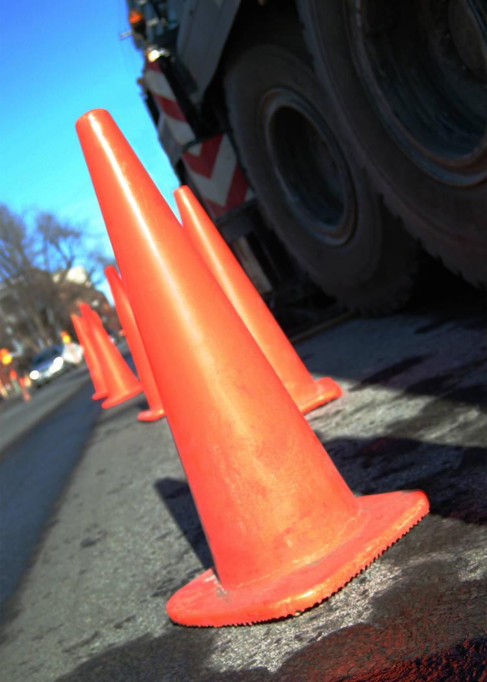
CLOSING DOWN THE FACILITY
When leaving the venue, place a cone in the center of the ring.

